Slide 1
BFS and DFS

Slide 2
topics
Breadth First Search (BFS)
Level Order Traversal
Depth First Search(DFS)
Topological Sorting

Slide 3
Breadth First SEarch

Slide 4
Graph Searching
Given: a graph G = (V, E), directed or undirected.
Goal: methodically explore (or visit) every vertex.
There are two standard graph traversal techniques:
  Breadth-First Search (BFS)
  Depth-First Search (DFS)
You will be requiring these two algorithms in the future too:
  Learning algorithms like Backtracking
  In Courses like Artificial Intelligence, DSA – II, etc.
  Developing software

Slide 5
Breadth-First Search
Building a tree over the graph (parent array)
  We will pick a source vertex to be the root
  We will find (“discover”) its children, then their children, etc.
Associating colors (colors array)
  White vertices have not been discovered : All vertices start out white
  Grey vertices are discovered but not fully explored :They may be adjacent to white vertices. Enqueuing will be done for these vertices.
  Black vertices are discovered and fully explored: They are adjacent only to black and grey vertices
Keeping track of distance from the root (distance array)
  Helps in determining how far a vertex is from the root
Using a queue (array based queue/ linked list based queue)
  Will be used for guiding the exploration

Slide 6
BFS Simulation
We can use arrays like before for this even though
the vertices are represented by characters
(use the ASCII values)
r
s
t
u
∞
∞
∞
∞
properties | r | s | t | u | v | w | x | Y
d | inf | inf | inf | inf | inf | inf | inf | inf
P | -1 | -1 | -1 | -1 | -1 | -1 | -1 | -1
c | w | w | w | w | w | w | w | W
∞
∞
∞
∞
v
w
x
y
Q
Initial vertex condition
  all the vertices will be at infinite distance from the source (source not picked yet).
  All the vertices will be colored w (not bee discovered)
  They will have no parent
An empty Queue

Slide 7
BFS Simulation
r
s
t
u
∞
∞
∞
∞
properties | r | s | t | u | v | w | x | Y
d | inf | inf | inf | inf | inf | inf | inf | inf
P | -1 | -1 | -1 | -1 | -1 | -1 | -1 | -1
c | w | w | w | w | w | w | w | W
∞
∞
∞
∞
v
w
x
y
Q
Let us take s as the source for this example.
  We will now update its attributes

Slide 8
BFS Simulation
r
s
t
u
∞
0
∞
∞
properties | r | s | t | u | v | w | x | Y
d | inf | 0 | inf | inf | inf | inf | inf | inf
P | -1 | -1 | -1 | -1 | -1 | -1 | -1 | -1
c | w | g | w | w | w | w | w | W
∞
∞
∞
∞
v
w
x
y
Q
s
Let us take s as the source for this example.
  We will now update its attributes
  Distance (from source) = 0 (as s itself is the source)
  Parent = -1 (no parent)
  Color=gray (discovered) . We are placing gray/discovered vertices in the queue

Slide 9
BFS Simulation
r
s
t
u
∞
0
∞
∞
properties | r | s | t | u | v | w | x | Y
d | inf | 0 | inf | inf | inf | inf | inf | inf
P | -1 | -1 | -1 | -1 | -1 | -1 | -1 | -1
c | w | g | w | w | w | w | w | W
∞
∞
∞
∞
v
w
x
y
Q
s
Let us take s as the source for this example.
  We will now update its attributes
  Distance (from source) = 0 (as s itself is the source)
  Parent = -1 (no parent)
  Color=gray (discovered) . We are placing gray/discovered vertices in the queue

Slide 10
BFS Simulation
r
s
t
u
∞
0
∞
∞
properties | r | s | t | u | v | w | x | Y
d | inf | 0 | inf | inf | inf | inf | inf | inf
P | -1 | -1 | -1 | -1 | -1 | -1 | -1 | -1
c | w | g | w | w | w | w | w | W
∞
∞
∞
∞
v
w
x
y
Q
s
Now keep on doing the following until the queue is empty
  Take out the topmost element
  Visit each of its neighbors
  If the neighbors are undiscovered (white)
    Mark them as discovered (color them with GRAY color and place them in queue)
    Update their distance, parent.
  Mark the taken out element as explored (Black – all its children has been discovered)

Slide 11
BFS Simulation
r
s
t
u
∞
0
∞
∞
properties | r | s | t | u | v | w | x | Y
d | inf | 0 | inf | inf | inf | inf | inf | inf
P | -1 | -1 | -1 | -1 | -1 | -1 | -1 | -1
c | w | g | w | w | w | w | w | W
∞
∞
∞
∞
v
w
x
y
Q
s
Now keep on doing the following until the queue is empty
  Take out the topmost element
  Visit each of its neighbors
  If the neighbors are undiscovered (white)
    Mark them as discovered (color them with GRAY color and place them in queue)
    Update their distance, parent.
  Mark the taken out element as explored (Black – all its children has been discovered)

Slide 12
BFS Simulation
r
s
t
u
∞
0
∞
∞
properties | r | s | t | u | v | w | x | Y
d | inf | 0 | inf | inf | inf | inf | inf | inf
P | -1 | -1 | -1 | -1 | -1 | -1 | -1 | -1
c | w | g | w | w | w | w | w | W
∞
∞
∞
∞
v
w
x
y
Q
s
Now keep on doing the following until the queue is empty
  Take out the topmost element
  Visit each of its neighbors
  If the neighbors are undiscovered (white)
    Mark them as discovered (color them with GRAY color and place them in queue)
    Update their distance, parent.
  Mark the taken out element as explored (Black – all its children has been discovered)

Slide 13

BFS Simulation
r
s
t
u
1
0
∞
∞
properties | r | s | t | u | v | w | x | Y
d | 1 | 0 | inf | inf | inf | 1 | inf | inf
P | s | -1 | -1 | -1 | -1 | s | -1 | -1
c | g | g | w | w | w | g | w | W
∞
1
∞
∞
v
w
x
y
Q
s
Now keep on doing the following until the queue is empty
  Take out the topmost element
  Visit each of its neighbors
  If the neighbors are undiscovered (white)
    Mark them as discovered (color them with GRAY color and place them in queue)
    Update their distance, parent.
  Mark the taken out element as explored (Black – all its children has been discovered)

Slide 14
BFS Simulation
r
s
t
u
1
0
∞
∞
properties | r | s | t | u | v | w | x | Y
d | 1 | 0 | inf | inf | inf | 1 | inf | inf
P | s | -1 | -1 | -1 | -1 | s | -1 | -1
c | g | g | w | w | w | g | w | W
∞
1
∞
∞
v
w
x
y
Q
s
r
w
Now keep on doing the following until the queue is empty
  Take out the topmost element
  Visit each of its neighbors
  If the neighbors are undiscovered (white)
    Mark them as discovered (color them with GRAY color and place them in queue)
    Update their distance, parent.
  Mark the taken out element as explored (Black – all its children has been discovered)

Slide 15

BFS Simulation
r
s
t
u
1
0
∞
∞
properties | r | s | t | u | v | w | x | Y
d | 1 | 0 | inf | inf | inf | 1 | inf | inf
P | s | -1 | -1 | -1 | -1 | s | -1 | -1
c | g | g | w | w | w | g | w | W
∞
1
∞
∞
v
w
x
y
Q
s
r
w
Now keep on doing the following until the queue is empty
  Take out the topmost element
  Visit each of its neighbors
  If the neighbors are undiscovered (white)
    Mark them as discovered (color them with GRAY color and place them in queue)
    Update their distance, parent.
  Mark the taken out element as explored (Black – all its children has been discovered)

Slide 16
BFS Simulation
r
s
t
u
1
0
∞
∞
properties | r | s | t | u | v | w | x | Y
d | 1 | 0 | inf | inf | inf | 1 | inf | inf
P | s | -1 | -1 | -1 | -1 | S | -1 | -1
c | g | g | w | w | w | g | w | W
∞
1
∞
∞
v
w
x
y
Q
s
r
w
Now keep on doing the following until the queue is empty
  Take out the topmost element
  Visit each of its neighbors
  If the neighbors are undiscovered (white)
    Mark them as discovered (color them with GRAY color and place them in queue)
    Update their distance, parent.
  Mark the taken out element as explored (Black – all its children has been discovered)

Slide 17
BFS Simulation
r
s
t
u
1
0
∞
∞
properties | r | s | t | u | v | w | x | Y
d | 1 | 0 | inf | inf | inf | 1 | inf | inf
P | S | -1 | -1 | -1 | -1 | S | -1 | -1
c | g | b | w | w | w | g | w | W
∞
1
∞
∞
v
w
x
y
Q
r
w
Now keep on doing the following until the queue is empty
  Take out the topmost element
  Visit each of its neighbors
  If the neighbors are undiscovered (white)
    Mark them as discovered (color them with GRAY color and place them in queue)
    Update their distance, parent.
  Mark the taken out element as explored (Black – all its children has been discovered)

Slide 18
BFS Simulation
r
s
t
u
1
0
∞
∞
properties | r | s | t | u | v | w | x | Y
d | 1 | 0 | inf | inf | inf | 1 | inf | inf
P | s | -1 | -1 | -1 | -1 | s | -1 | -1
c | g | b | w | w | w | g | w | W
∞
1
∞
∞
v
w
x
y
Q
r
w
Now keep on doing the following until the queue is empty
  Take out the topmost element
  Visit each of its neighbors
  If the neighbors are undiscovered (white)
    Mark them as discovered (color them with GRAY color and place them in queue)
    Update their distance, parent.
  Mark the taken out element as explored (Black – all its children has been discovered)

Slide 19
BFS Simulation
r
s
t
u
1
0
∞
∞
properties | r | s | t | u | v | w | x | Y
d | 1 | 0 | inf | inf | inf | 1 | inf | inf
P | s | -1 | -1 | -1 | -1 | s | -1 | -1
c | g | b | w | w | w | g | w | W
∞
1
∞
∞
v
w
x
y
Q
r
w
Now keep on doing the following until the queue is empty
  Take out the topmost element
  Visit each of its neighbors
  If the neighbors are undiscovered (white)
    Mark them as discovered (color them with GRAY color and place them in queue)
    Update their distance, parent.
  Mark the taken out element as explored (Black – all its children has been discovered)

Slide 20
BFS Simulation
r
s
t
u
1
0
∞
∞
properties | r | s | t | u | v | w | x | Y
d | 1 | 0 | inf | inf | inf | 1 | inf | inf
P | s | -1 | -1 | -1 | -1 | s | -1 | -1
c | g | b | w | w | w | g | w | W
∞
1
∞
∞
v
w
x
y
Q
r
w
Now keep on doing the following until the queue is empty
  Take out the topmost element
  Visit each of its neighbors
  If the neighbors are undiscovered (white)
    Mark them as discovered (color them with GRAY color and place them in queue)
    Update their distance, parent.
  Mark the taken out element as explored (Black – all its children has been discovered)

Slide 21
BFS Simulation
r
s
t
u
1
0
∞
∞
properties | r | s | t | u | v | w | x | Y
d | 1 | 0 | inf | inf | 2 | 1 | inf | inf
P | s | -1 | -1 | -1 | 1 | s | -1 | -1
c | g | b | w | w | g | g | w | W
2
1
∞
∞
v
w
x
y
Q
r
w
v
Now keep on doing the following until the queue is empty
  Take out the topmost element
  Visit each of its neighbors
  If the neighbors are undiscovered (white)
    Mark them as discovered (color them with GRAY color and place them in queue)
    Update their distance, parent.
  Mark the taken out element as explored (Black – all its children has been discovered)

Slide 22
BFS Simulation
r
s
t
u
1
0
∞
∞
properties | r | s | t | u | v | w | x | Y
d | 1 | 0 | inf | inf | 2 | 1 | inf | inf
P | s | -1 | -1 | -1 | 1 | s | -1 | -1
c | b | b | w | w | g | g | w | W
2
1
∞
∞
v
w
x
y
Q
r
w
v
Now keep on doing the following until the queue is empty
  Take out the topmost element
  Visit each of its neighbors
  If the neighbors are undiscovered (white)
    Mark them as discovered (color them with GRAY color and place them in queue)
    Update their distance, parent.
  Mark the taken out element as explored (Black – all its children has been discovered)

Slide 23
BFS Simulation
r
s
t
u
1
0
∞
∞
properties | r | s | t | u | v | w | x | Y
d | 1 | 0 | inf | inf | 2 | 1 | inf | inf
P | s | -1 | -1 | -1 | 1 | s | -1 | -1
c | b | b | w | w | g | g | w | W
2
1
∞
∞
v
w
x
y
Q
w
v
Now keep on doing the following until the queue is empty
  Take out the topmost element
  Visit each of its neighbors
  If the neighbors are undiscovered (white)
    Mark them as discovered (color them with GRAY color and place them in queue)
    Update their distance, parent.
  Mark the taken out element as explored (Black – all its children has been discovered)

Slide 24
BFS Simulation
r
s
t
u
1
0
∞
∞
properties | r | s | t | u | v | w | x | Y
d | 1 | 0 | inf | inf | 2 | 1 | inf | inf
P | s | -1 | -1 | -1 | 1 | s | -1 | -1
c | b | b | w | w | g | g | w | W
2
1
∞
∞
v
w
x
y
Q
w
v
Now keep on doing the following until the queue is empty
  Take out the topmost element
  Visit each of its neighbors
  If the neighbors are undiscovered (white)
    Mark them as discovered (color them with GRAY color and place them in queue)
    Update their distance, parent.
  Mark the taken out element as explored (Black – all its children has been discovered)

Slide 25
BFS Simulation
r
s
t
u
1
0
∞
∞
properties | r | s | t | u | v | w | x | Y
d | 1 | 0 | inf | inf | 2 | 1 | inf | inf
P | s | -1 | -1 | -1 | 1 | s | -1 | -1
c | b | b | w | w | g | g | w | W
2
1
∞
∞
v
w
x
y
Q
w
v
Now keep on doing the following until the queue is empty
  Take out the topmost element
  Visit each of its neighbors
  If the neighbors are undiscovered (white)
    Mark them as discovered (color them with GRAY color and place them in queue)
    Update their distance, parent.
  Mark the taken out element as explored (Black – all its children has been discovered)

Slide 26
BFS Simulation
r
s
t
u
1
0
2
∞
properties | r | s | t | u | v | w | x | Y
d | 1 | 0 | 2 | inf | 2 | 1 | 2 | inf
P | s | -1 | w | -1 | 1 | s | w | -1
c | b | b | g | w | g | g | g | w
2
1
2
∞
v
w
x
y
Q
w
v
Now keep on doing the following until the queue is empty
  Take out the topmost element
  Visit each of its neighbors
  If the neighbors are undiscovered (white)
    Mark them as discovered (color them with GRAY color and place them in queue)
    Update their distance, parent.
  Mark the taken out element as explored (Black – all its children has been discovered)

Slide 27
BFS Simulation
r
s
t
u
1
0
2
∞
properties | r | s | t | u | v | w | x | Y
d | 1 | 0 | 2 | inf | 2 | 1 | 2 | inf
P | s | -1 | w | -1 | 1 | s | w | -1
c | b | b | g | w | g | g | g | w
2
1
2
∞
v
w
x
y
Q
w
v
t
x
Now keep on doing the following until the queue is empty
  Take out the topmost element
  Visit each of its neighbors
  If the neighbors are undiscovered (white)
    Mark them as discovered (color them with GRAY color and place them in queue)
    Update their distance, parent.
  Mark the taken out element as explored (Black – all its children has been discovered)

Slide 28
BFS Simulation
r
s
t
u
1
0
2
∞
properties | r | s | t | u | v | w | x | Y
d | 1 | 0 | 2 | inf | 2 | 1 | 2 | inf
P | s | -1 | w | -1 | 1 | s | w | -1
c | b | b | g | w | g | b | g | w
2
1
2
∞
v
w
x
y
Q
v
t
x
Now keep on doing the following until the queue is empty
  Take out the topmost element
  Visit each of its neighbors
  If the neighbors are undiscovered (white)
    Mark them as discovered (color them with GRAY color and place them in queue)
    Update their distance, parent.
  Mark the taken out element as explored (Black – all its children has been discovered)

Slide 29
BFS Simulation
r
s
t
u
1
0
2
∞
properties | r | s | t | u | v | w | x | Y
d | 1 | 0 | 2 | inf | 2 | 1 | 2 | inf
P | s | -1 | w | -1 | 1 | s | w | -1
c | b | b | g | w | g | b | g | w
2
1
2
∞
v
w
x
y
Q
v
t
x
Now keep on doing the following until the queue is empty
  Take out the topmost element
  Visit each of its neighbors
  If the neighbors are undiscovered (white)
    Mark them as discovered (color them with GRAY color and place them in queue)
    Update their distance, parent.
  Mark the taken out element as explored (Black – all its children has been discovered)

Slide 30
BFS Simulation
r
s
t
u
1
0
2
∞
properties | r | s | t | u | v | w | x | Y
d | 1 | 0 | 2 | inf | 2 | 1 | 2 | inf
P | s | -1 | w | -1 | 1 | s | w | -1
c | b | b | g | w | g | b | g | w
2
1
2
∞
v
w
x
y
Q
v
t
x
Now keep on doing the following until the queue is empty
  Take out the topmost element
  Visit each of its neighbors
  If the neighbors are undiscovered (white)
    Mark them as discovered (color them with GRAY color and place them in queue)
    Update their distance, parent.
  Mark the taken out element as explored (Black – all its children has been discovered)

Slide 31
BFS Simulation
r
s
t
u
1
0
2
∞
properties | r | s | t | u | v | w | x | Y
d | 1 | 0 | 2 | inf | 2 | 1 | 2 | inf
P | s | -1 | w | -1 | 1 | s | w | -1
c | b | b | g | w | g | b | g | w
2
1
2
∞
v
w
x
y
Q
v
t
x
Now keep on doing the following until the queue is empty
  Take out the topmost element
  Visit each of its neighbors
  If the neighbors are undiscovered (white)
    Mark them as discovered (color them with GRAY color and place them in queue)
    Update their distance, parent.
  Mark the taken out element as explored (Black – all its children has been discovered)

Slide 32
BFS Simulation
r
s
t
u
1
0
2
∞
properties | r | s | t | u | v | w | x | Y
d | 1 | 0 | 2 | inf | 2 | 1 | 2 | inf
P | s | -1 | w | -1 | 1 | s | w | -1
c | b | b | g | w | g | b | g | w
2
1
2
∞
v
w
x
y
Q
v
t
x
Now keep on doing the following until the queue is empty
  Take out the topmost element
  Visit each of its neighbors
  If the neighbors are undiscovered (white)
    Mark them as discovered (color them with GRAY color and place them in queue)
    Update their distance, parent.
  Mark the taken out element as explored (Black – all its children has been discovered)

Slide 33
BFS Simulation
r
s
t
u
1
0
2
∞
properties | r | s | t | u | v | w | x | Y
d | 1 | 0 | 2 | inf | 2 | 1 | 2 | inf
P | s | -1 | w | -1 | 1 | s | w | -1
c | b | b | g | w | b | b | g | w
2
1
2
∞
v
w
x
y
Q
v
t
x
Now keep on doing the following until the queue is empty
  Take out the topmost element
  Visit each of its neighbors
  If the neighbors are undiscovered (white)
    Mark them as discovered (color them with GRAY color and place them in queue)
    Update their distance, parent.
  Mark the taken out element as explored (Black – all its children has been discovered)

Slide 34
BFS Simulation
r
s
t
u
1
0
2
∞
properties | r | s | t | u | v | w | x | Y
d | 1 | 0 | 2 | inf | 2 | 1 | 2 | inf
P | s | -1 | w | -1 | 1 | s | w | -1
c | b | b | g | w | b | b | g | w
2
1
2
∞
v
w
x
y
Q
t
x
Now keep on doing the following until the queue is empty
  Take out the topmost element
  Visit each of its neighbors
  If the neighbors are undiscovered (white)
    Mark them as discovered (color them with GRAY color and place them in queue)
    Update their distance, parent.
  Mark the taken out element as explored (Black – all its children has been discovered)

Slide 35
BFS Simulation
r
s
t
u
1
0
2
∞
properties | r | s | t | u | v | w | x | Y
d | 1 | 0 | 2 | inf | 2 | 1 | 2 | inf
P | s | -1 | w | -1 | 1 | s | w | -1
c | b | b | g | w | b | b | g | w
2
1
2
∞
v
w
x
y
Q
t
x
Now keep on doing the following until the queue is empty
  Take out the topmost element
  Visit each of its neighbors
  If the neighbors are undiscovered (white)
    Mark them as discovered (color them with GRAY color and place them in queue)
    Update their distance, parent.
  Mark the taken out element as explored (Black – all its children has been discovered)

Slide 36
BFS Simulation
r
s
t
u
1
0
2
∞
properties | r | s | t | u | v | w | x | Y
d | 1 | 0 | 2 | inf | 2 | 1 | 2 | inf
P | s | -1 | w | -1 | 1 | s | w | -1
c | b | b | g | w | b | b | g | w
2
1
2
∞
v
w
x
y
Q
t
x
Now keep on doing the following until the queue is empty
  Take out the topmost element
  Visit each of its neighbors
  If the neighbors are undiscovered (white)
    Mark them as discovered (color them with GRAY color and place them in queue)
    Update their distance, parent.
  Mark the taken out element as explored (Black – all its children has been discovered)

Slide 37
BFS Simulation
r
s
t
u
1
0
2
∞
properties | r | s | t | u | v | w | x | Y
d | 1 | 0 | 2 | inf | 2 | 1 | 2 | inf
P | s | -1 | w | -1 | 1 | s | w | -1
c | b | b | g | w | b | b | g | w
2
1
2
∞
v
w
x
y
Q
t
x
Now keep on doing the following until the queue is empty
  Take out the topmost element
  Visit each of its neighbors
  If the neighbors are undiscovered (white)
    Mark them as discovered (color them with GRAY color and place them in queue)
    Update their distance, parent.
  Mark the taken out element as explored (Black – all its children has been discovered)

Slide 38
BFS Simulation
r
s
t
u
1
0
2
3
properties | r | s | t | u | v | w | x | Y
d | 1 | 0 | 2 | 3 | 2 | 1 | 2 | inf
P | s | -1 | w | t | 1 | s | w | -1
c | b | b | g | g | b | b | g | w
2
1
2
∞
v
w
x
y
Q
t
x
u
Now keep on doing the following until the queue is empty
  Take out the topmost element
  Visit each of its neighbors
  If the neighbors are undiscovered (white)
    Mark them as discovered (color them with GRAY color and place them in queue)
    Update their distance, parent.
  Mark the taken out element as explored (Black – all its children has been discovered)

Slide 39
BFS Simulation
r
s
t
u
1
0
2
3
properties | r | s | t | u | v | w | x | Y
d | 1 | 0 | 2 | 3 | 2 | 1 | 2 | inf
P | s | -1 | w | t | 1 | s | w | -1
c | b | b | b | g | b | b | g | w
2
1
2
∞
v
w
x
y
Q
t
x
u
Now keep on doing the following until the queue is empty
  Take out the topmost element
  Visit each of its neighbors
  If the neighbors are undiscovered (white)
    Mark them as discovered (color them with GRAY color and place them in queue)
    Update their distance, parent.
  Mark the taken out element as explored (Black – all its children has been discovered)

Slide 40
BFS Simulation
r
s
t
u
1
0
2
3
properties | r | s | t | u | v | w | x | Y
d | 1 | 0 | 2 | 3 | 2 | 1 | 2 | inf
P | s | -1 | w | t | 1 | s | w | -1
c | b | b | b | g | b | b | g | w
2
1
2
∞
v
w
x
y
Q
x
u
Now keep on doing the following until the queue is empty
  Take out the topmost element
  Visit each of its neighbors
  If the neighbors are undiscovered (white)
    Mark them as discovered (color them with GRAY color and place them in queue)
    Update their distance, parent.
  Mark the taken out element as explored (Black – all its children has been discovered)

Slide 41
BFS Simulation
r
s
t
u
1
0
2
3
properties | r | s | t | u | v | w | x | Y
d | 1 | 0 | 2 | 3 | 2 | 1 | 2 | inf
P | s | -1 | w | t | 1 | s | w | -1
c | b | b | b | g | b | b | g | w
2
1
2
∞
v
w
x
y
Q
x
u
Now keep on doing the following until the queue is empty
  Take out the topmost element
  Visit each of its neighbors
  If the neighbors are undiscovered (white)
    Mark them as discovered (color them with GRAY color and place them in queue)
    Update their distance, parent.
  Mark the taken out element as explored (Black – all its children has been discovered)

Slide 42
BFS Simulation
r
s
t
u
1
0
2
3
properties | r | s | t | u | v | w | x | Y
d | 1 | 0 | 2 | 3 | 2 | 1 | 2 | inf
P | s | -1 | w | t | 1 | s | w | -1
c | b | b | b | g | b | b | g | w
2
1
2
∞
v
w
x
y
Q
x
u
Now keep on doing the following until the queue is empty
  Take out the topmost element
  Visit each of its neighbors
  If the neighbors are undiscovered (white)
    Mark them as discovered (color them with GRAY color and place them in queue)
    Update their distance, parent.
  Mark the taken out element as explored (Black – all its children has been discovered)

Slide 43
BFS Simulation
r
s
t
u
1
0
2
3
properties | r | s | t | u | v | w | x | Y
d | 1 | 0 | 2 | 3 | 2 | 1 | 2 | inf
P | s | -1 | w | t | 1 | s | w | -1
c | b | b | b | g | b | b | g | w
2
1
2
∞
v
w
x
y
Q
x
u
Now keep on doing the following until the queue is empty
  Take out the topmost element
  Visit each of its neighbors
  If the neighbors are undiscovered (white)
    Mark them as discovered (color them with GRAY color and place them in queue)
    Update their distance, parent.
  Mark the taken out element as explored (Black – all its children has been discovered)

Slide 44
BFS Simulation
r
s
t
u
1
0
2
3
properties | r | s | t | u | v | w | x | Y
d | 1 | 0 | 2 | 3 | 2 | 1 | 2 | inf
P | s | -1 | w | t | 1 | s | w | -1
c | b | b | b | g | b | b | g | w
2
1
2
∞
v
w
x
y
Q
x
u
Now keep on doing the following until the queue is empty
  Take out the topmost element
  Visit each of its neighbors
  If the neighbors are undiscovered (white)
    Mark them as discovered (color them with GRAY color and place them in queue)
    Update their distance, parent.
  Mark the taken out element as explored (Black – all its children has been discovered)

Slide 45
BFS Simulation
r
s
t
u
1
0
2
3
properties | r | s | t | u | v | w | x | Y
d | 1 | 0 | 2 | 3 | 2 | 1 | 2 | 3
P | s | -1 | w | t | 1 | s | w | X
c | b | b | b | g | b | b | g | g
2
1
2
3
v
w
x
y
Q
x
u
y
Now keep on doing the following until the queue is empty
  Take out the topmost element
  Visit each of its neighbors
  If the neighbors are undiscovered (white)
    Mark them as discovered (color them with GRAY color and place them in queue)
    Update their distance, parent.
  Mark the taken out element as explored (Black – all its children has been discovered)

Slide 46
BFS Simulation
r
s
t
u
1
0
2
3
properties | r | s | t | u | v | w | x | Y
d | 1 | 0 | 2 | 3 | 2 | 1 | 2 | 3
P | s | -1 | w | t | 1 | s | w | X
c | b | b | b | g | b | b | b | g
2
1
2
3
v
w
x
y
Q
x
u
y
Now keep on doing the following until the queue is empty
  Take out the topmost element
  Visit each of its neighbors
  If the neighbors are undiscovered (white)
    Mark them as discovered (color them with GRAY color and place them in queue)
    Update their distance, parent.
  Mark the taken out element as explored (Black – all its children has been discovered)

Slide 47
BFS Simulation
r
s
t
u
1
0
2
3
properties | r | s | t | u | v | w | x | Y
d | 1 | 0 | 2 | 3 | 2 | 1 | 2 | 3
P | s | -1 | w | t | 1 | s | w | X
c | b | b | b | g | b | b | b | g
2
1
2
3
v
w
x
y
Q
u
y
Now keep on doing the following until the queue is empty
  Take out the topmost element
  Visit each of its neighbors
  If the neighbors are undiscovered (white)
    Mark them as discovered (color them with GRAY color and place them in queue)
    Update their distance, parent.
  Mark the taken out element as explored (Black – all its children has been discovered)

Slide 48
BFS Simulation
r
s
t
u
1
0
2
3
properties | r | s | t | u | v | w | x | Y
d | 1 | 0 | 2 | 3 | 2 | 1 | 2 | 3
P | s | -1 | w | t | 1 | s | w | X
c | b | b | b | g | b | b | b | g
2
1
2
3
v
w
x
y
Q
u
y
Now keep on doing the following until the queue is empty
  Take out the topmost element
  Visit each of its neighbors
  If the neighbors are undiscovered (white)
    Mark them as discovered (color them with GRAY color and place them in queue)
    Update their distance, parent.
  Mark the taken out element as explored (Black – all its children has been discovered)

Slide 49
BFS Simulation
r
s
t
u
1
0
2
3
properties | r | s | t | u | v | w | x | Y
d | 1 | 0 | 2 | 3 | 2 | 1 | 2 | 3
P | s | -1 | w | t | 1 | s | w | X
c | b | b | b | g | b | b | b | g
2
1
2
3
v
w
x
y
Q
u
y
Now keep on doing the following until the queue is empty
  Take out the topmost element
  Visit each of its neighbors
  If the neighbors are undiscovered (white)
    Mark them as discovered (color them with GRAY color and place them in queue)
    Update their distance, parent.
  Mark the taken out element as explored (Black – all its children has been discovered)

Slide 50
BFS Simulation
r
s
t
u
1
0
2
3
properties | r | s | t | u | v | w | x | Y
d | 1 | 0 | 2 | 3 | 2 | 1 | 2 | 3
P | s | -1 | w | t | 1 | s | w | X
c | b | b | b | g | b | b | b | g
2
1
2
3
v
w
x
y
Q
u
y
Now keep on doing the following until the queue is empty
  Take out the topmost element
  Visit each of its neighbors
  If the neighbors are undiscovered (white)
    Mark them as discovered (color them with GRAY color and place them in queue)
    Update their distance, parent.
  Mark the taken out element as explored (Black – all its children has been discovered)

Slide 51
BFS Simulation
r
s
t
u
1
0
2
3
properties | r | s | t | u | v | w | x | Y
d | 1 | 0 | 2 | 3 | 2 | 1 | 2 | 3
P | s | -1 | w | t | 1 | s | w | X
c | b | b | b | b | b | b | b | g
2
1
2
3
v
w
x
y
Q
u
y
Now keep on doing the following until the queue is empty
  Take out the topmost element
  Visit each of its neighbors
  If the neighbors are undiscovered (white)
    Mark them as discovered (color them with GRAY color and place them in queue)
    Update their distance, parent.
  Mark the taken out element as explored (Black – all its children has been discovered)

Slide 52
BFS Simulation
r
s
t
u
1
0
2
3
properties | r | s | t | u | v | w | x | Y
d | 1 | 0 | 2 | 3 | 2 | 1 | 2 | 3
P | s | -1 | w | t | 1 | s | w | X
c | b | b | b | b | b | b | b | g
2
1
2
3
v
w
x
y
Q
y
Now keep on doing the following until the queue is empty
  Take out the topmost element
  Visit each of its neighbors
  If the neighbors are undiscovered (white)
    Mark them as discovered (color them with GRAY color and place them in queue)
    Update their distance, parent.
  Mark the taken out element as explored (Black – all its children has been discovered)

Slide 53
BFS Simulation
r
s
t
u
1
0
2
3
properties | r | s | t | u | v | w | x | Y
d | 1 | 0 | 2 | 3 | 2 | 1 | 2 | 3
P | s | -1 | w | t | 1 | s | w | X
c | b | b | b | b | b | b | b | g
2
1
2
3
v
w
x
y
Q
y
Now keep on doing the following until the queue is empty
  Take out the topmost element
  Visit each of its neighbors
  If the neighbors are undiscovered (white)
    Mark them as discovered (color them with GRAY color and place them in queue)
    Update their distance, parent.
  Mark the taken out element as explored (Black – all its children has been discovered)

Slide 54
BFS Simulation
r
s
t
u
1
0
2
3
properties | r | s | t | u | v | w | x | Y
d | 1 | 0 | 2 | 3 | 2 | 1 | 2 | 3
P | s | -1 | w | t | 1 | s | w | X
c | b | b | b | b | b | b | b | g
2
1
2
3
v
w
x
y
Q
y
Now keep on doing the following until the queue is empty
  Take out the topmost element
  Visit each of its neighbors
  If the neighbors are undiscovered (white)
    Mark them as discovered (color them with GRAY color and place them in queue)
    Update their distance, parent.
  Mark the taken out element as explored (Black – all its children has been discovered)

Slide 55
BFS Simulation
r
s
t
u
1
0
2
3
properties | r | s | t | u | v | w | x | Y
d | 1 | 0 | 2 | 3 | 2 | 1 | 2 | 3
P | s | -1 | w | t | 1 | s | w | X
c | b | b | b | b | b | b | b | g
2
1
2
3
v
w
x
y
Q
y
Now keep on doing the following until the queue is empty
  Take out the topmost element
  Visit each of its neighbors
  If the neighbors are undiscovered (white)
    Mark them as discovered (color them with GRAY color and place them in queue)
    Update their distance, parent.
  Mark the taken out element as explored (Black – all its children has been discovered)

Slide 56
BFS Simulation
r
s
t
u
1
0
2
3
properties | r | s | t | u | v | w | x | Y
d | 1 | 0 | 2 | 3 | 2 | 1 | 2 | 3
P | s | -1 | w | t | 1 | s | w | X
c | b | b | b | b | b | b | b | g
2
1
2
3
v
w
x
y
Q
Now keep on doing the following until the queue is empty
  Take out the topmost element
  Visit each of its neighbors
  If the neighbors are undiscovered (white)
    Mark them as discovered (color them with GRAY color and place them in queue)
    Update their distance, parent.
  Mark the taken out element as explored (Black – all its children has been discovered)

Slide 57

BFS Simulation
r
s
t
u
1
0
2
3
properties | r | s | t | u | v | w | x | Y
d | 1 | 0 | 2 | 3 | 2 | 1 | 2 | 3
P | s | -1 | w | t | 1 | s | w | X
c | b | b | b | b | b | b | b | g
2
1
2
3
v
w
x
y
Q
Now keep on doing the following until the queue is empty
  Take out the topmost element
  Visit each of its neighbors
  If the neighbors are undiscovered (white)
    Mark them as discovered (color them with GRAY color and place them in queue)
    Update their distance, parent.
  Mark the taken out element as explored (Black – all its children has been discovered)

Slide 58
BFS Discovery Pattern
0
0
1
A
B
C
D
A
B
C
D
E
F
G
H
E
F
G
H
I
J
K
L
I
J
K
L
M
N
O
P
M
N
O
P

Slide 59
Breadth-First Search: Properties
BFS calculates the shortest-path along with its distance to the source node
  Shortest-path distance δ(s,v) = minimum number of edges from s to v, or ∞ if v not reachable from s
BFS builds breadth-first tree, in which paths to root represent shortest paths in G
  Thus can use BFS to calculate shortest path from one vertex to another in O(V+E) time in an unweighted tree

Slide 60
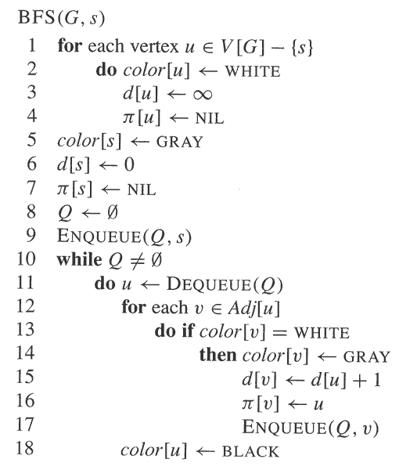
Let us Formulate the BFS Pseudocode

Slide 61
Level order traversal

Slide 62
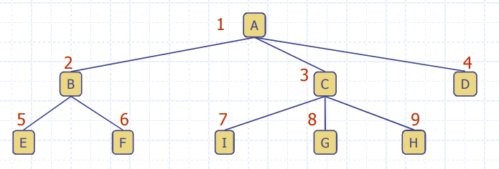
Level order traversal
Run BFS from the root
Print the node when you color it black

Slide 63
Depth First Search

Slide 64
Depth First Search
We can simply replace the queue with a stack.
However, this time we want to work with two other attributes:
  Discovery Time
  Finish Time
Hence we are using the recursive version.
  You will understand this after the simulation.

Slide 65
Depth-First Search
Depth-first search is another strategy for exploring a graph
  Explore “deeper” in the graph whenever possible
  Edges are explored out of the most recently discovered vertex v that still has unexplored edges
  When all of v’s edges have been explored, backtrack to the vertex from which v was discovered (Recursion is used here)
Vertex Colors:
  Vertices initially colored white
  Then colored grey when discovered
  Then black when finished
Times
  Discovery Time (d)
  Returning Time / Exploration Completion Time (f)
Running time
  running time of DFS = O(V+E)

Slide 66
DFS Simulation
Consider two functions:
DFS(G)
{
for each vertex u ∈ G->V
{
u->color = WHITE;
}
time = 0;
for each vertex u ∈ G->V
{
if (u->color == WHITE)
DFS_Visit(u);
}
}
DFS_Visit(u)
{
u->color = GREY;
time = time+1;
u->d = time;
for each v ∈ u->Adj[]
{
if (v->color == WHITE)
DFS_Visit(v);
}
u->color = BLACK;
time = time+1;
u->f = time;
}

Slide 67
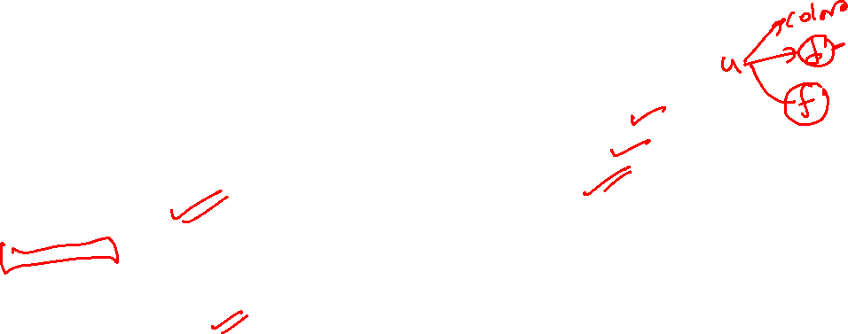
DFS Simulation
Consider two functions:
DFS(G)
{
for each vertex u ∈ G->V
{
u->color = WHITE;
}
time = 0;
for each vertex u ∈ G->V
{
if (u->color == WHITE)
DFS_Visit(u);
}
}
DFS_Visit(u)
{
u->color = GREY;
time = time+1;
u->d = time;
for each v ∈ u->Adj[]
{
if (v->color == WHITE)
DFS_Visit(v);
}
u->color = BLACK;
time = time+1;
u->f = time;
}
1. Initialization
2.Ensures that visiting done for all vertices

Slide 68

DFS Simulation
Consider two functions:
DFS(G)
{
for each vertex u ∈ G->V
{
u->color = WHITE;
}
time = 0;
for each vertex u ∈ G->V
{
if (u->color == WHITE)
DFS_Visit(u);
}
}
DFS_Visit(u)
{
u->color = GREY;
time = time+1;
u->d = time;
for each v ∈ u->Adj[]
{
if (v->color == WHITE)
DFS_Visit(v);
}
u->color = BLACK;
time = time+1;
u->f = time;
}
Visits a vertex
Updates its color and discovery time
Recursively visits the white neighbors
Updates the color and closure time
1. Initialization
2.Ensures that visiting done for all vertices

Slide 69
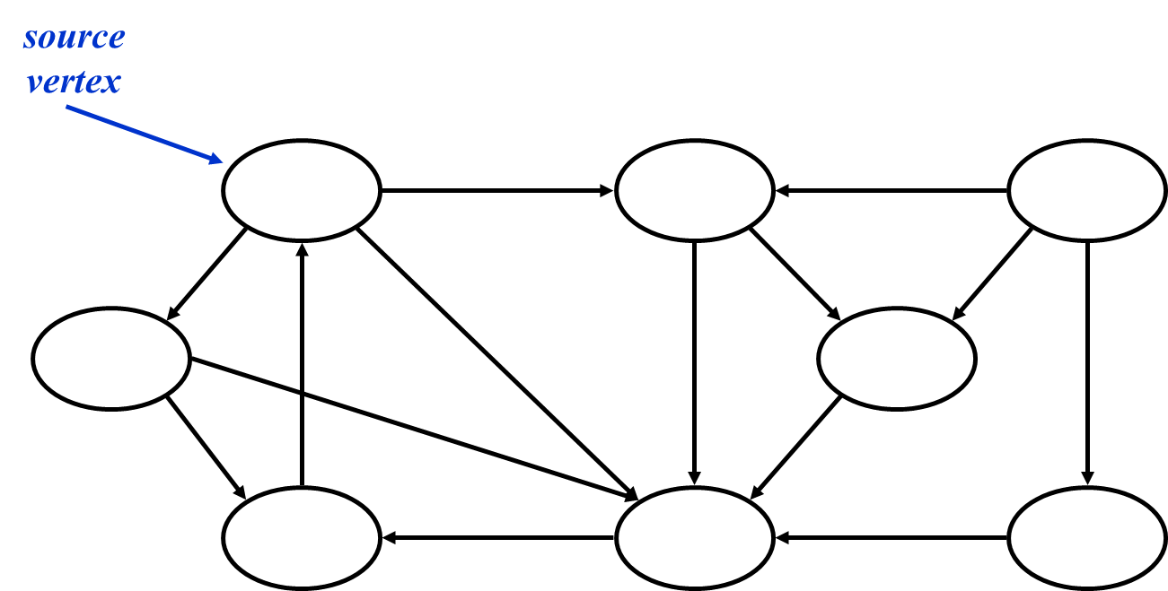

DFS Simulation
DFS Visit

Slide 70
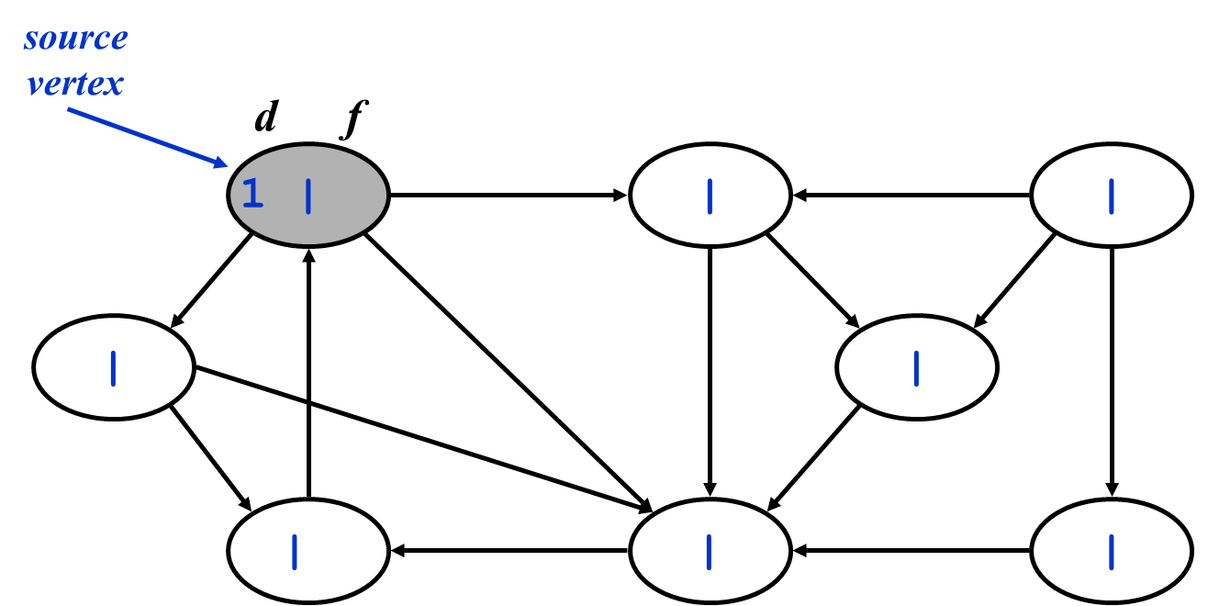

DFS Simulation
DFS Visit
DFS Visit

Slide 71
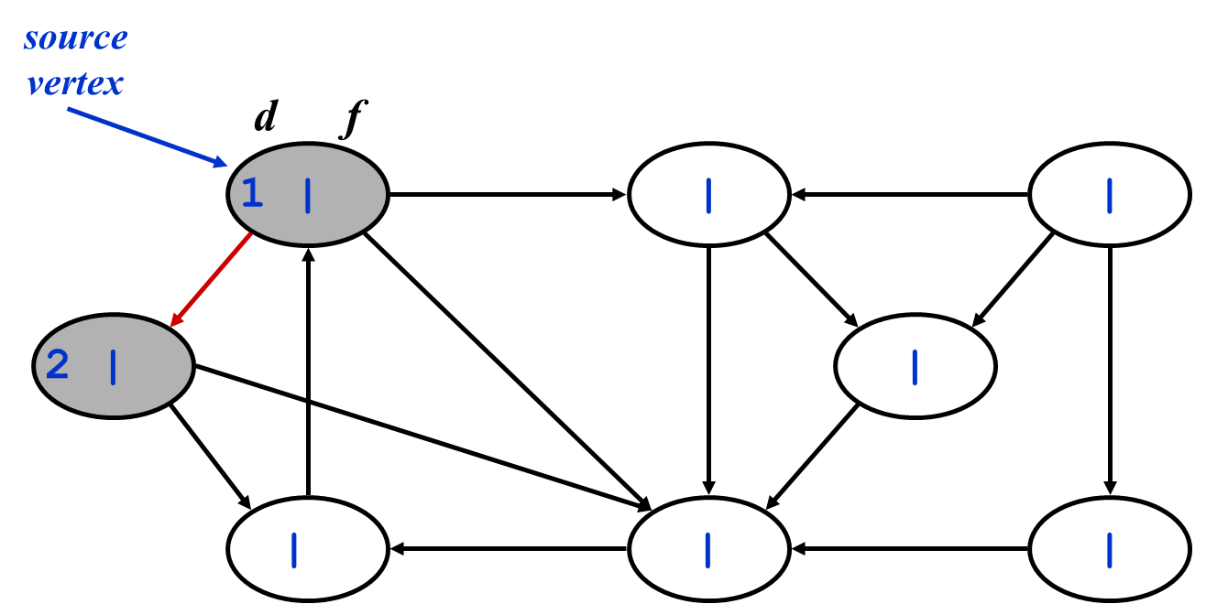

DFS Simulation
DFS Visit
DFS Visit

Slide 72
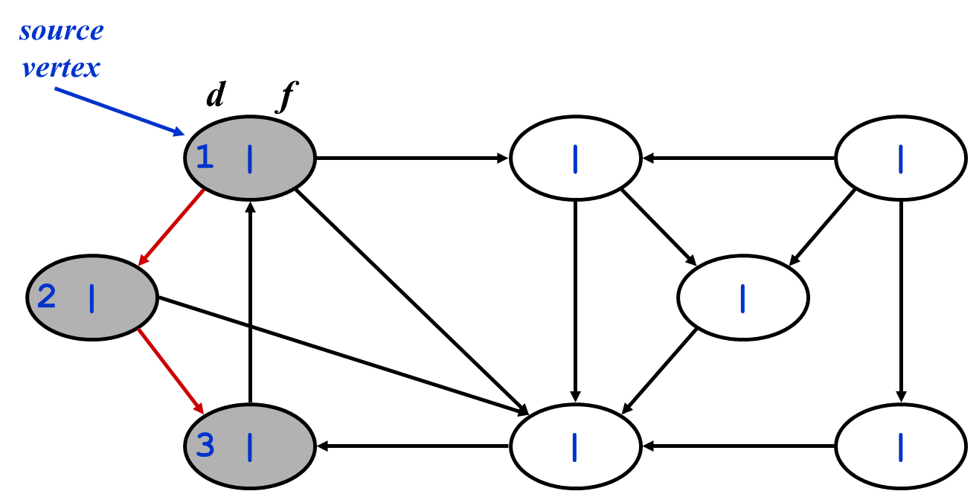
DFS Simulation
DFS Visit
DFS Visit
DFS Visit

Slide 73
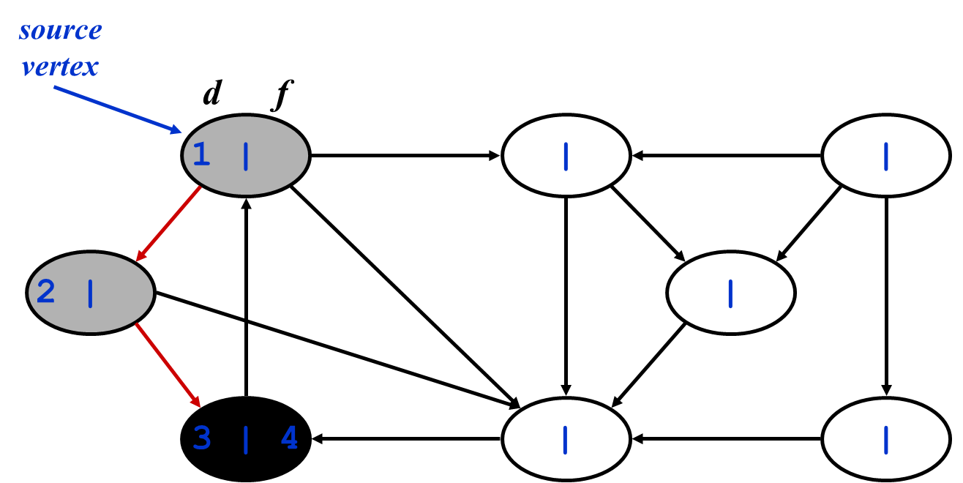
DFS Simulation
DFS Visit
DFS Visit

Slide 74
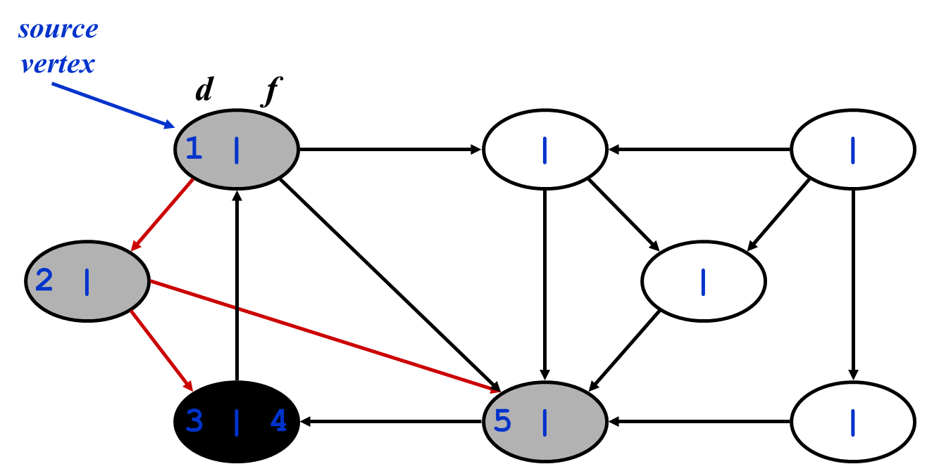

DFS Simulation
DFS Visit
DFS Visit
DFS Visit

Slide 75
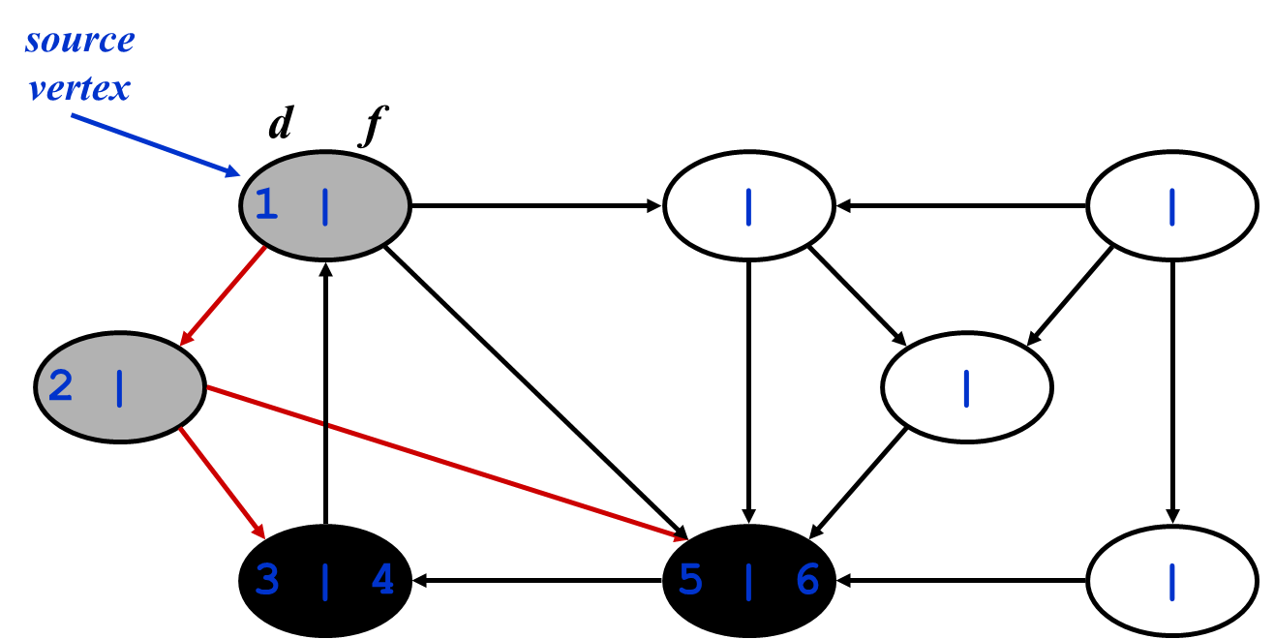
DFS Simulation
DFS Visit
DFS Visit

Slide 76
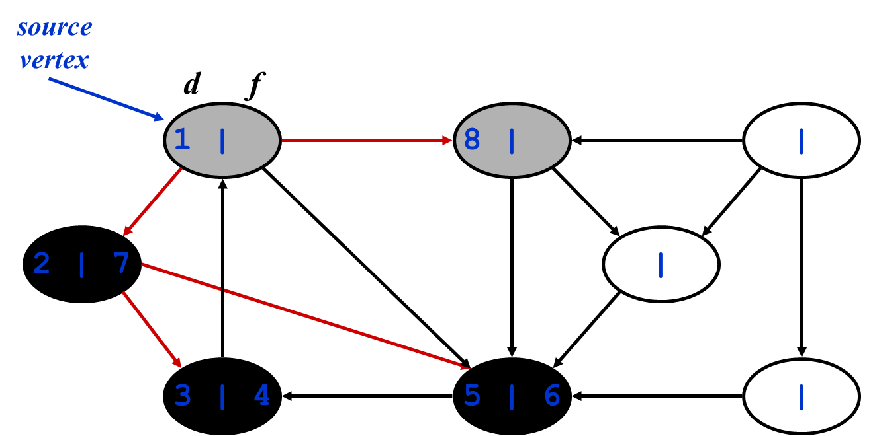
DFS Simulation
DFS Visit
|

Slide 77
DFS Simulation
DFS Visit
DFS Visit

Slide 78
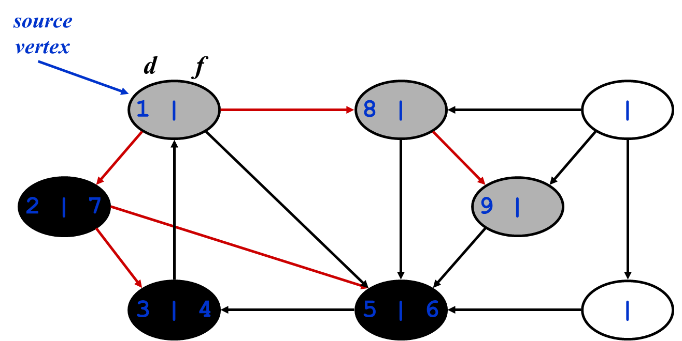
DFS Simulation
DFS Visit
DFS Visit
DFS Visit

Slide 79
DFS Simulation
DFS Visit
DFS Visit
DFS Visit

Slide 80
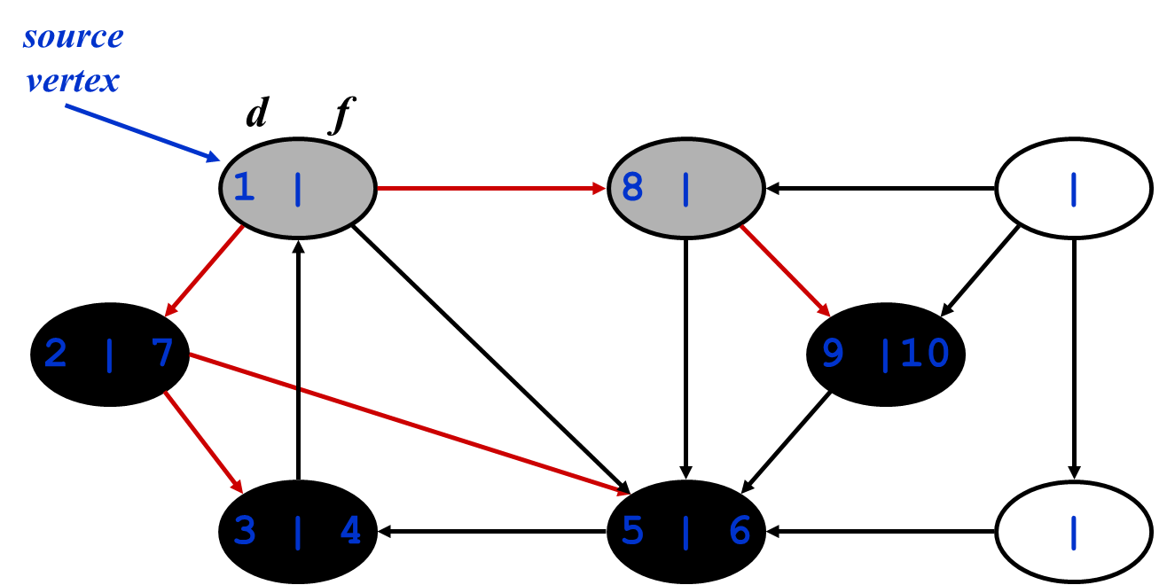
DFS Simulation
DFS Visit
DFS Visit

Slide 81
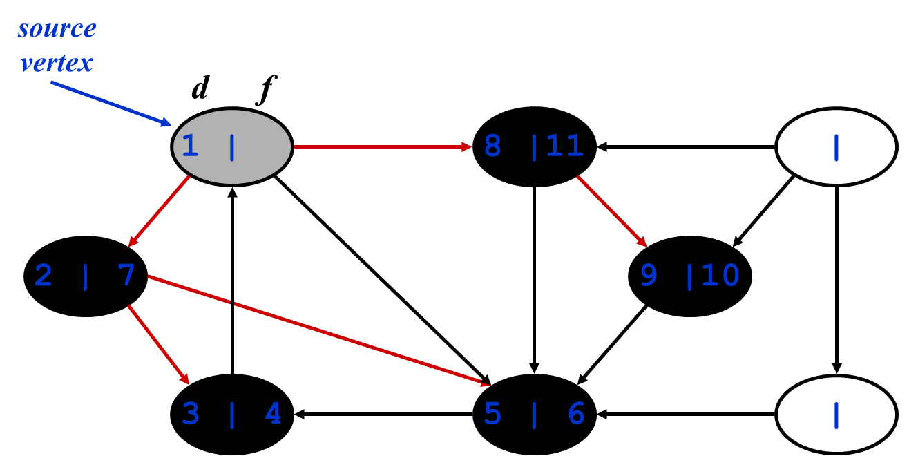
DFS Simulation
DFS Visit

Slide 82
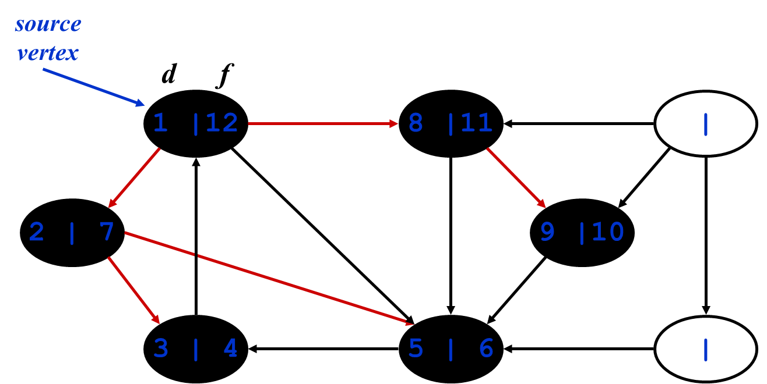
DFS Simulation

Slide 83



DFS Simulation
Recall these two functions:
DFS(G)
{
for each vertex u ∈ G->V
{
u->color = WHITE;
}
time = 0;
for each vertex u ∈ G->V
{
if (u->color == WHITE)
DFS_Visit(u);
}
}
DFS_Visit(u)
{
u->color = GREY;
time = time+1;
u->d = time;
for each v ∈ u->Adj[]
{
if (v->color == WHITE)
DFS_Visit(v);
}
u->color = BLACK;
time = time+1;
u->f = time;
}

Slide 84
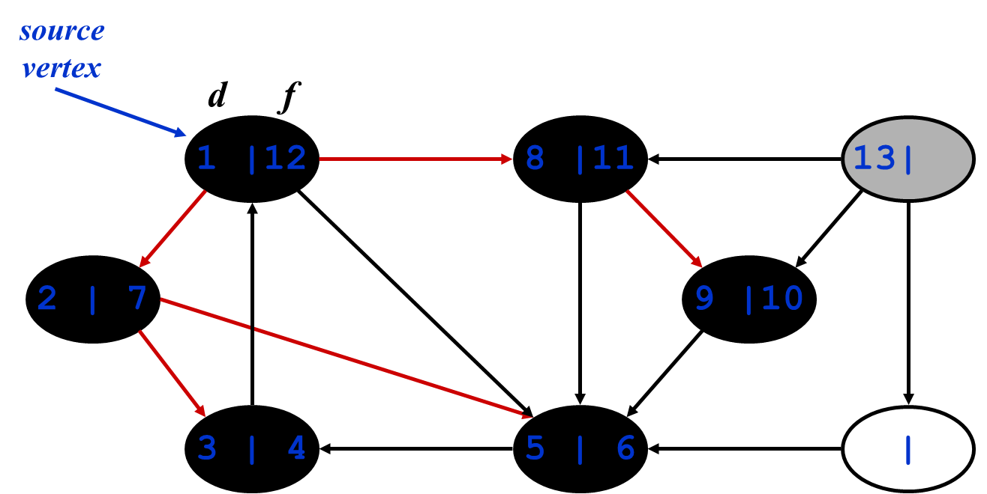
DFS Simulation
DFS Visit

Slide 85
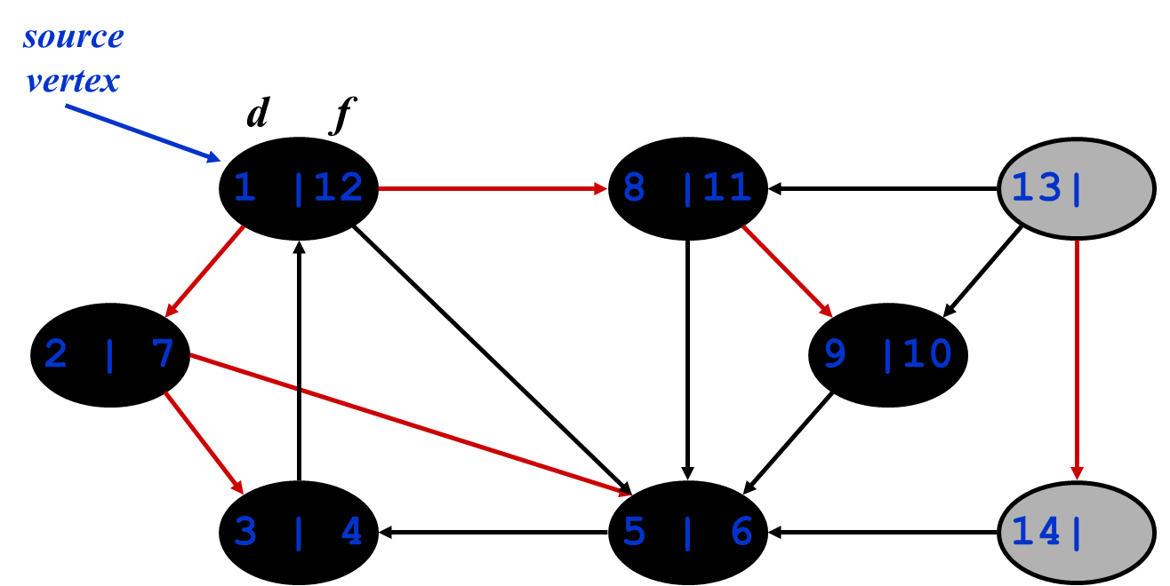
DFS Simulation
DFS Visit
DFS Visit

Slide 86
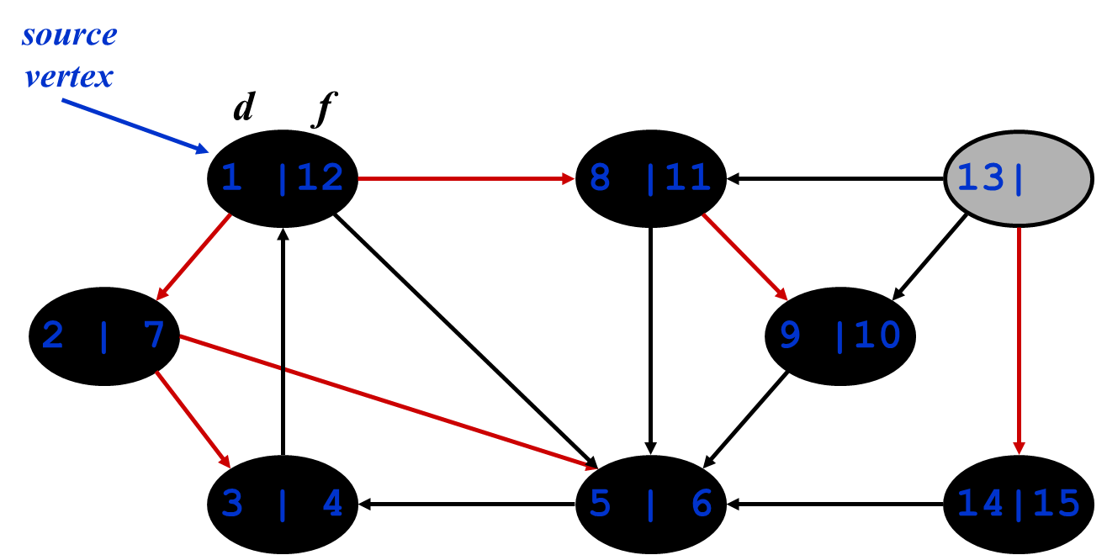
DFS Simulation
DFS Visit

Slide 87

DFS Simulation
source
vertex
d f
1 |12
8 |11
13|16
2 | 7
9 |10
3 | 4
5 | 6
14|15

Slide 88
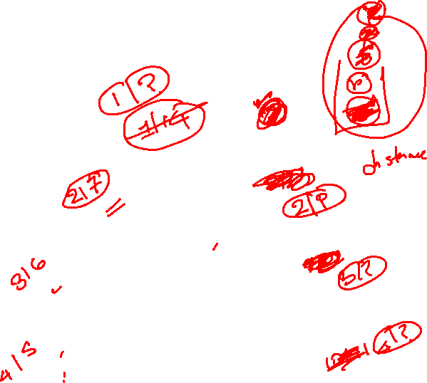
DFS Simulation
Could we achieve the same result using a stack based implementation?
  Let us try both approaches with this graph
  Attributes:
    Discovery Time (Time when vertex is colored grey)
    Finish Time (Time when vertex is colored black)
    Color
s
r
t
w
x
y
z

Slide 89
Directed acyclic graph and topological sorting

Slide 90
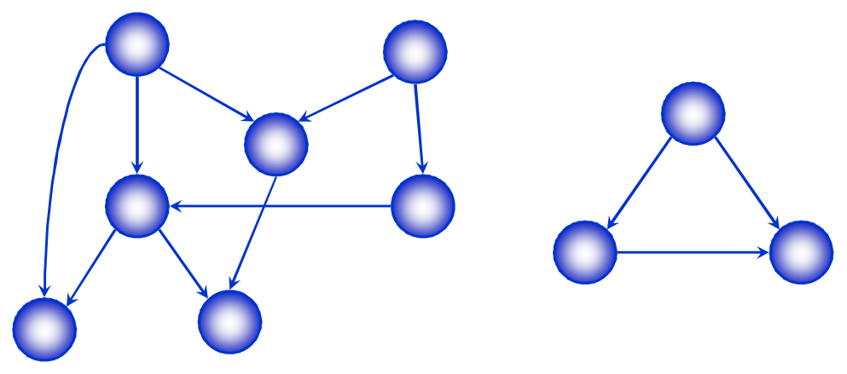
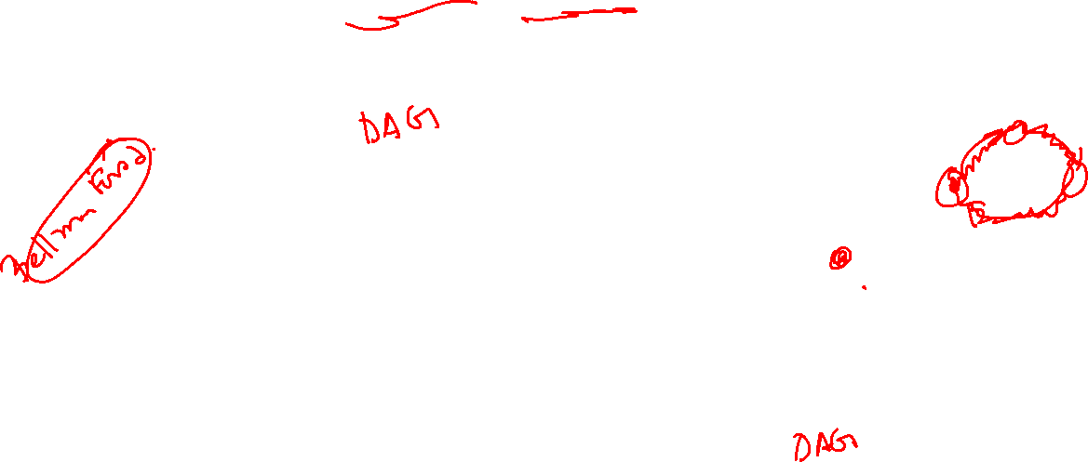
Directed Acyclic Graphs
A directed acyclic graph or DAG is a directed graph with no directed cycles

Slide 91

Topological Sort
A topological sort of a Directed Acyclic Graph G = (V, E) is a linear ordering of all its vertices such that if G contains an edge (u,v) then u appears before in the ordering.
If the graph contains a cycle, then no linear ordering is possible.
We can view a topological sort of a graph as an ordering of its vertices along a horizontal line so that all directed edges go from left to right.
Topological sorting is thus different from the usual kind of “sorting” we studied earlier.
It is useful for sorting events

Slide 92
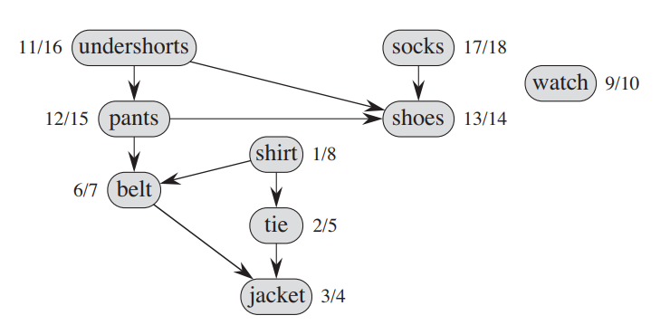
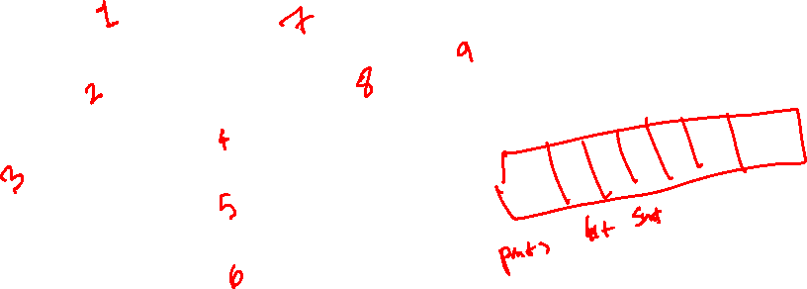
Topological Sort
Reference: Cormen et. al., Introduction to Algorithms, Figure 22.7
How can you store the attributes of these
Vertices without a vertex number?

Slide 93
Topological Sort
Reference: Cormen et. al., Introduction to Algorithms, Figure 22.7
How can you sort this graph?

Slide 94

Topological Sort
Reference: Cormen et. al., Introduction to Algorithms, Figure 22.7

Slide 95
Topological Sort
Reference: Cormen et. al., Introduction to Algorithms, Figure 22.7
Socks
Undershorts
Pants
Shoes
Watch
Shirt
Belt
Tie
Jacket

Slide 96
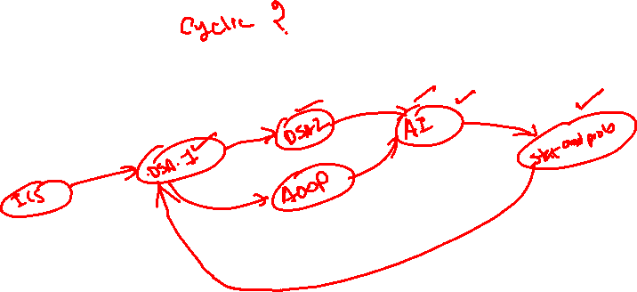
Topological Sort
Why do we need Directed Acyclic Graphs for Topological Sorting to work?
  Circular Dependency would arise instead of linear dependency

Slide 97
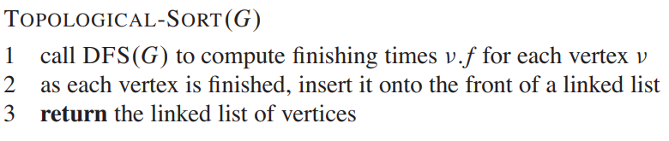
Topological Sort - Algorithm

Slide 98
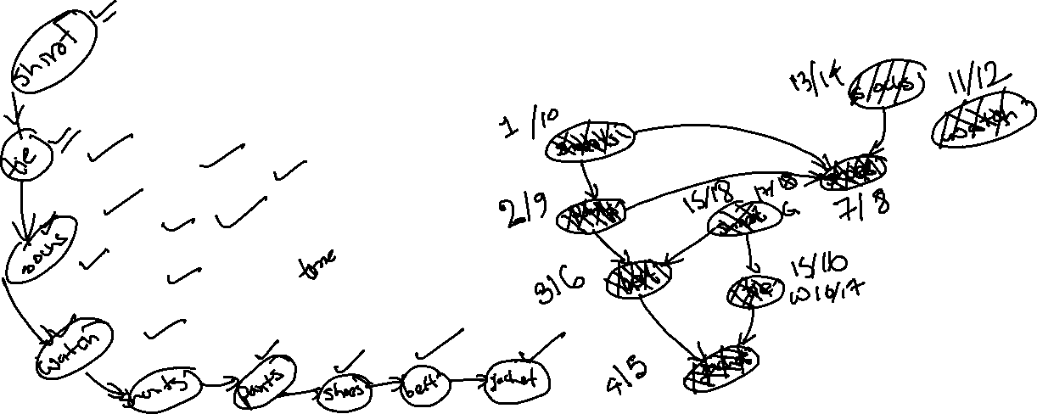
Topological Sort - Algorithm

Slide 99
Topological Sort - Algorithm

Slide 100
Topological Sort - Algorithm
Time Complexity : O(V+E) – Same as DFS

Slide 101
Topological Sort Algorithm (In Degree Method)
undershorts
socks
pants
watch
shoes
shirt
belt
tie
jacket

Slide 102
Topological Sort Algorithm (In Degree Method)
0
undershorts
0
socks
0
1
pants
watch
shoes
0
3
shirt
2
belt
tie
1
jacket
2

Slide 103
Topological Sort Algorithm (In Degree Method)
0
undershorts
0
socks
0
1
pants
watch
shoes
0
3
shirt
2
belt
tie
1
jacket
2

Slide 104

Topological Sort Algorithm (In Degree Method)
0
socks
0
1
pants
watch
shoes
0
3
shirt
2
belt
tie
1
jacket
2
undershorts

Slide 105
Topological Sort Algorithm (In Degree Method)
0
socks
0
0
pants
watch
shoes
0
2
shirt
2
belt
tie
1
jacket
2
undershorts

Slide 106
Topological Sort Algorithm (In Degree Method)
0
socks
0
0
pants
watch
shoes
0
2
shirt
2
belt
tie
1
jacket
2
undershorts

Slide 107

Topological Sort Algorithm (In Degree Method)
0
0
0
pants
watch
shoes
0
2
shirt
2
belt
tie
1
jacket
2
undershorts
socks

Slide 108
Topological Sort Algorithm (In Degree Method)
0
0
pants
watch
shoes
0
1
shirt
2
belt
tie
1
jacket
2
undershorts
socks

Slide 109

Topological Sort Algorithm (In Degree Method)
0
0
pants
watch
shoes
0
1
shirt
2
belt
tie
1
jacket
2
undershorts
socks

Slide 110
Topological Sort Algorithm (In Degree Method)
0
0
watch
shoes
0
1
shirt
2
belt
tie
1
jacket
2
undershorts
socks
pants

Slide 111
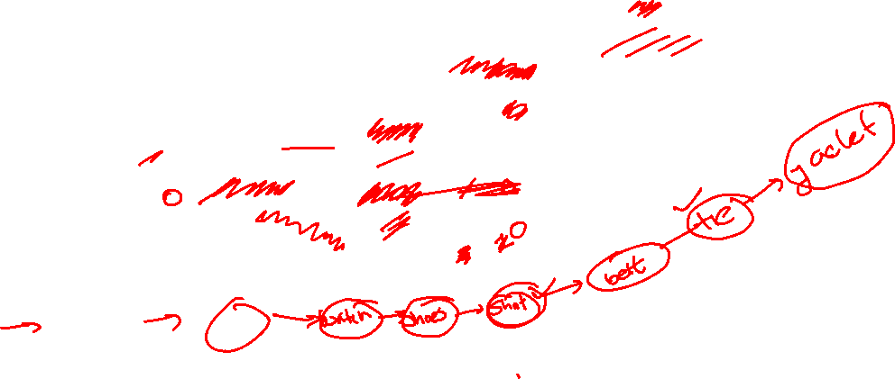
Topological Sort Algorithm (In Degree Method)
Keep on going like this until every vertex is
removed and inserted in to the tail of the list
0
watch
shoes
0
0
shirt
1
belt
tie
1
jacket
2
undershorts
socks
pants

Slide 112
Thank You

